Slide 1
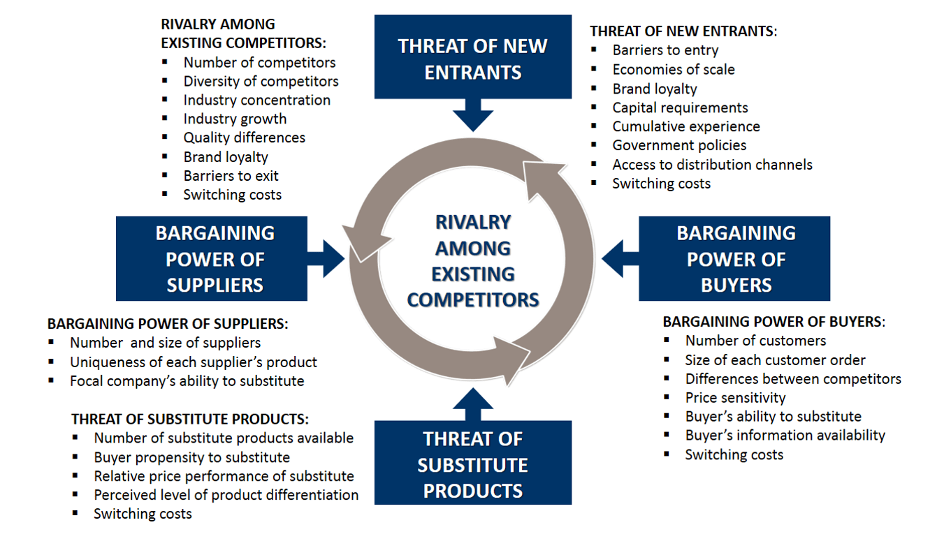
Analysis for our start-up:
The 5 Forces of the Market
Bargaining Power of Suppliers
Opportunities | Threats
Threat of new Entrants
Opportunities | Threats
Threat of Substitute Products
Opportunities | Threats
Bargaining Power of Buyers
Opportunities | Threats

Slide 2
Analysis for our start-up:
PEST Factors in the Environment
Political aspects |  | Economical aspects
Opportunities | Threats | Opportunities | Threats
Social aspects |  | Technological aspects
Opportunities | Threats | Opportunities | Threats

Slide 3
Analysis for our start-up:
SWOT / TOWS
 | Opportunities | Threats
Strengths
Weaknesses

